Slide 1

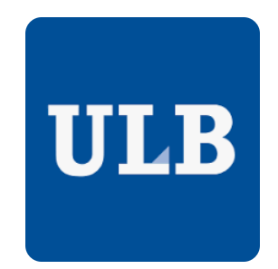
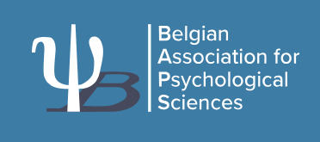

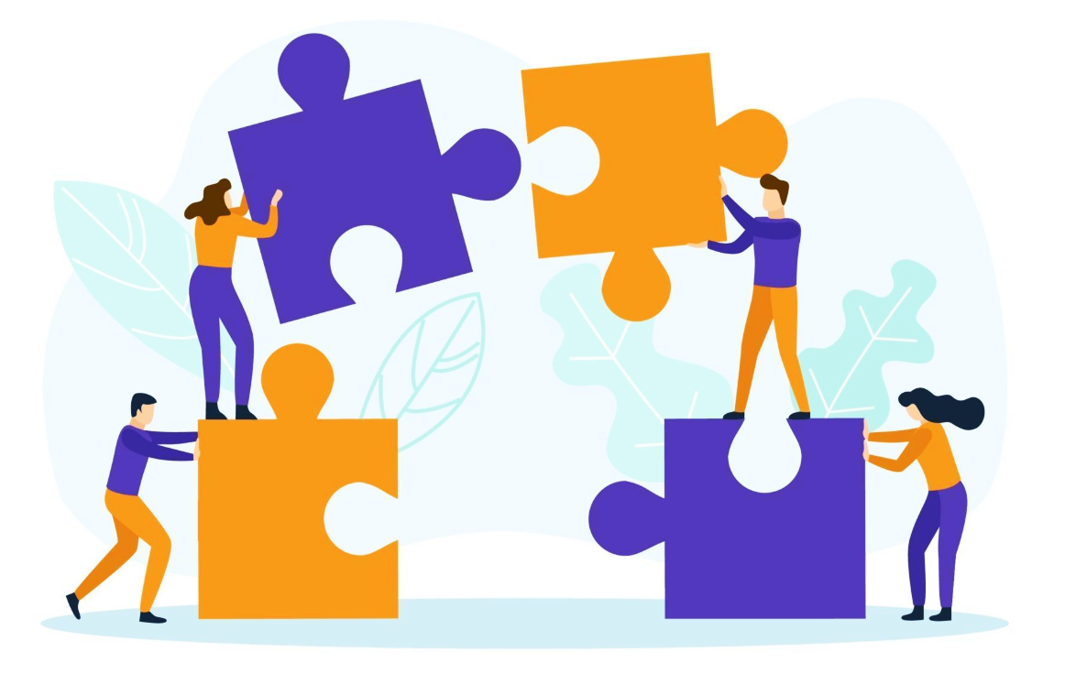
2026 Annual meeting of the Belgian Association for Psychological Sciences
Exploring teachers, parents and school directors' perspectives on parental school involvement in the French-speaking community of Belgium.
A multi-informant qualitative study
Annalisa Soncini & Stijn Van Petegem
Université libre de Bruxelles

Slide 2
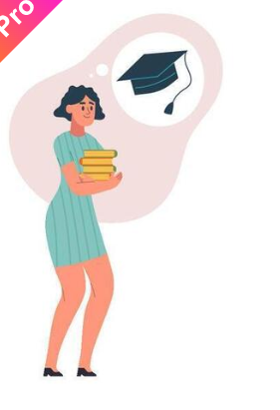
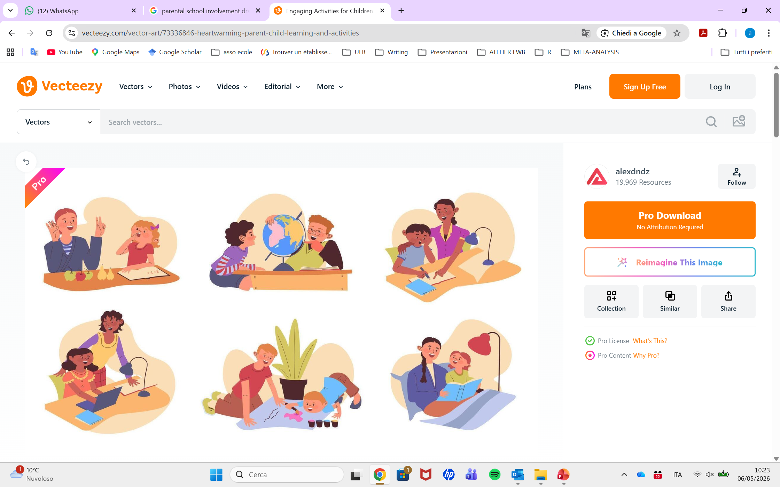
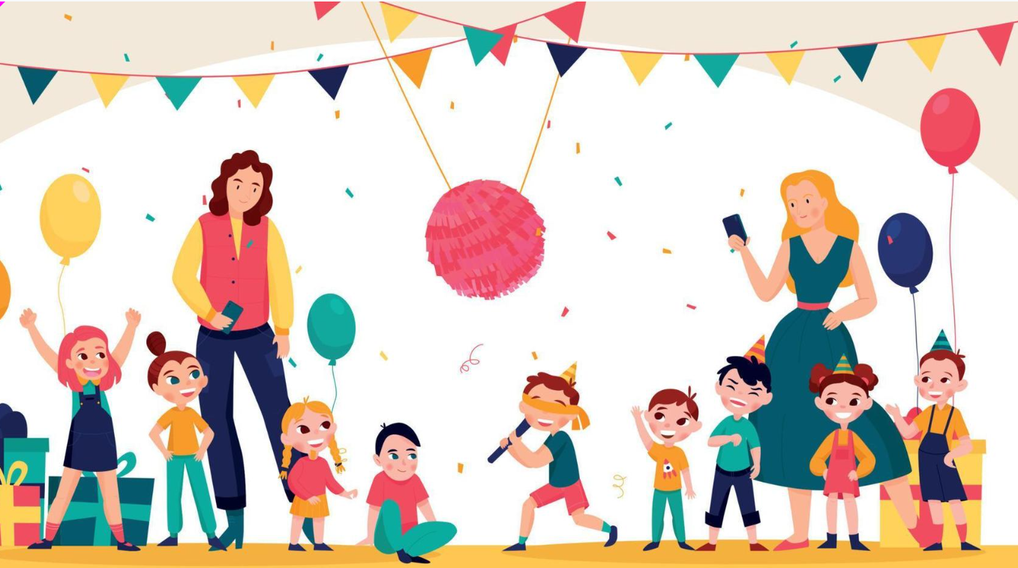
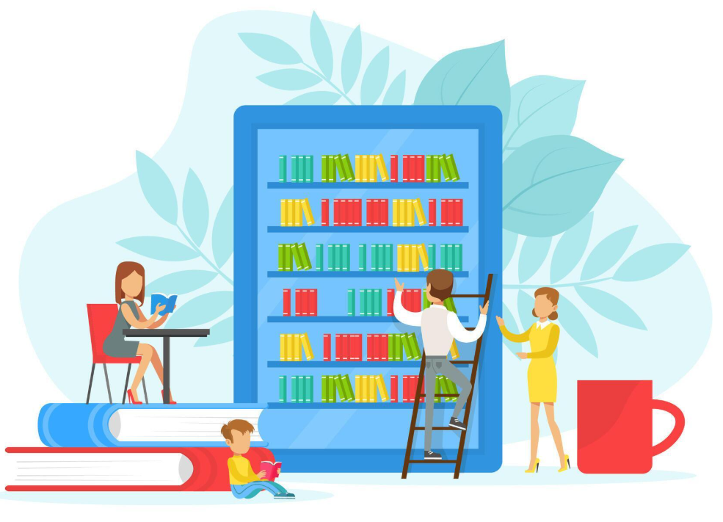
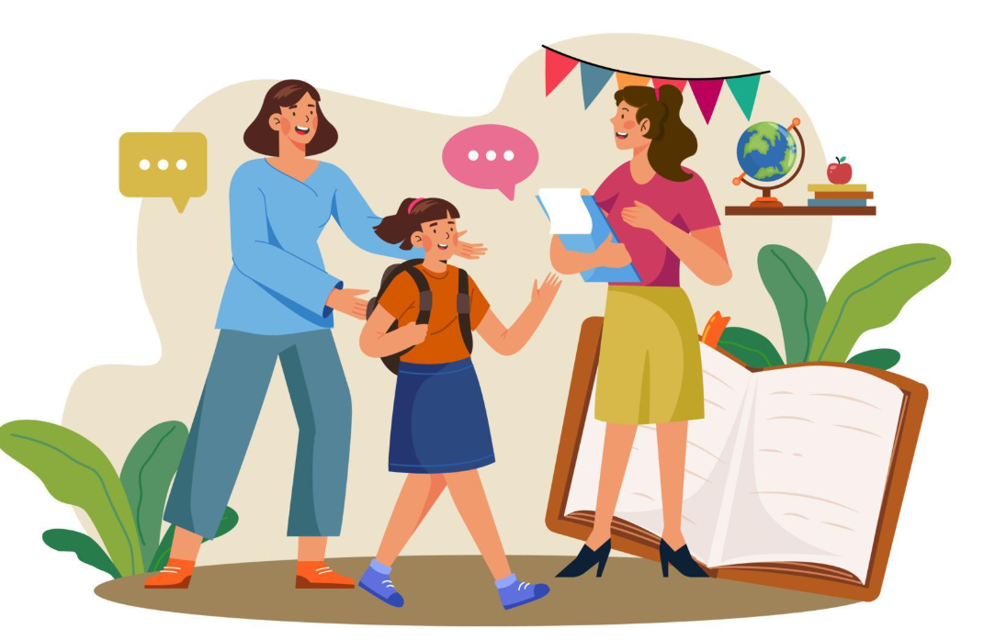
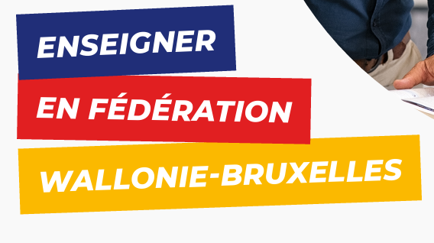
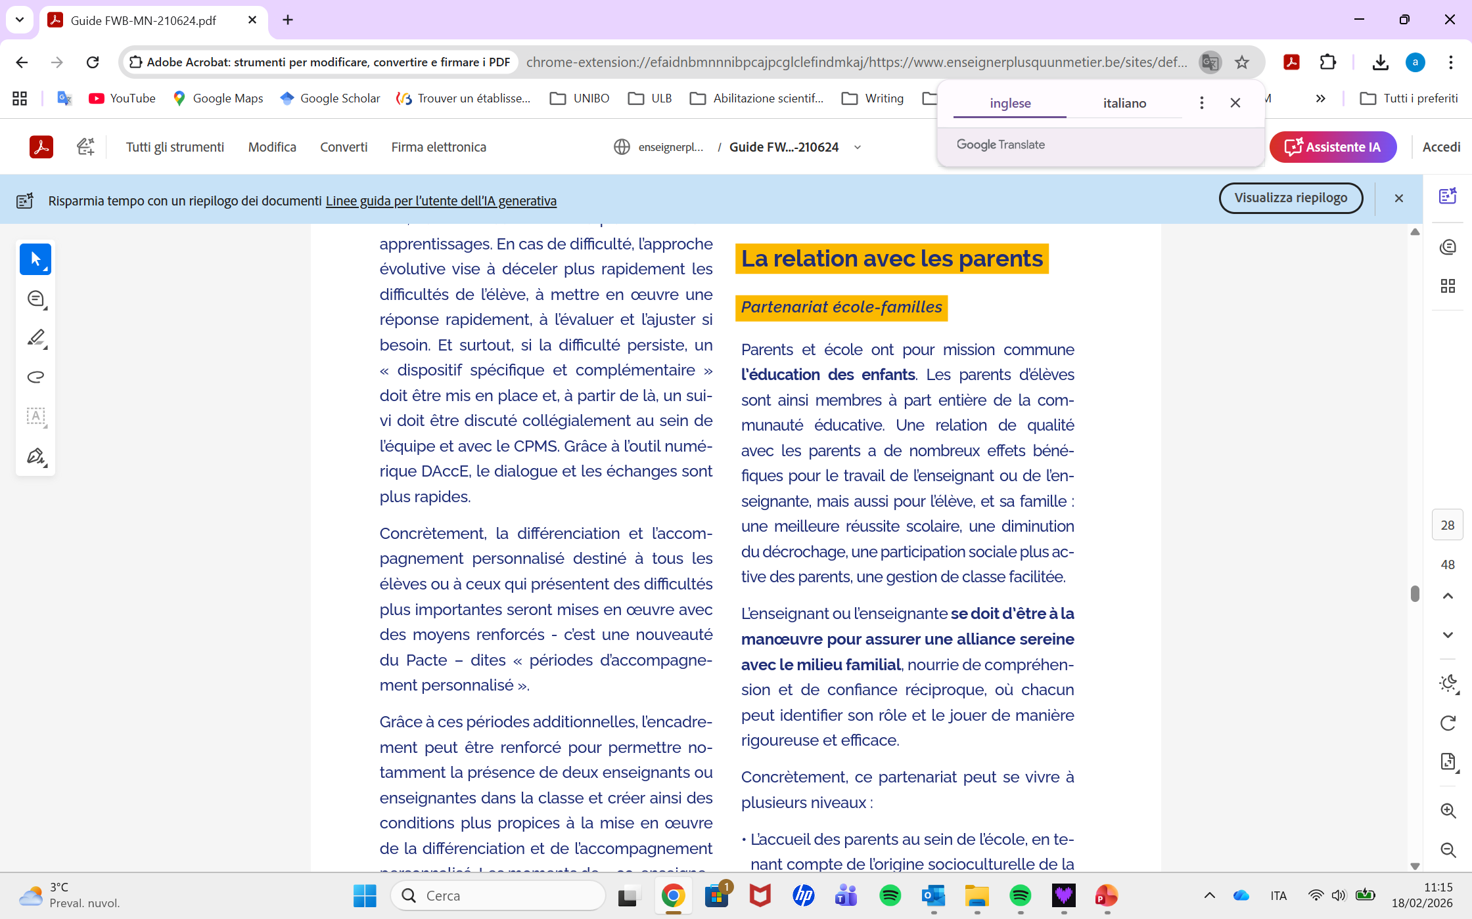
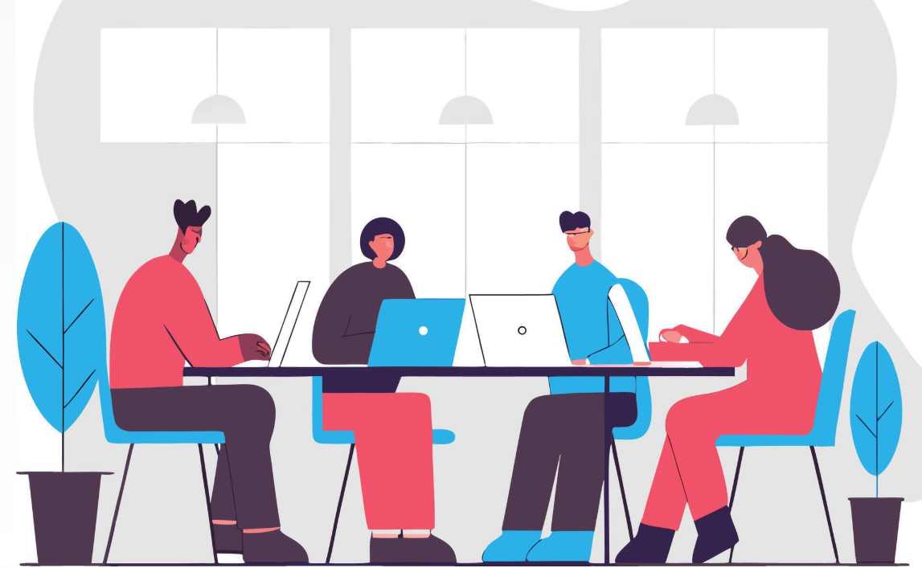
Parental involvement: What are we talking about?
School-based involvement and home-based involvement
High PI is related to better students’ achievement and well-being
Effective PI influences teachers’ behaviours, well-being and job satisfaction
PI is important to promote school-family partnership
Including parents is part of the school and teachers’ role
(Hoover-Dempsey & Sandler, 1997; OECD, 2025; Soncini et al., 2026; Stormont et al., 2013; Zaulaf et al., 2019)

Slide 3
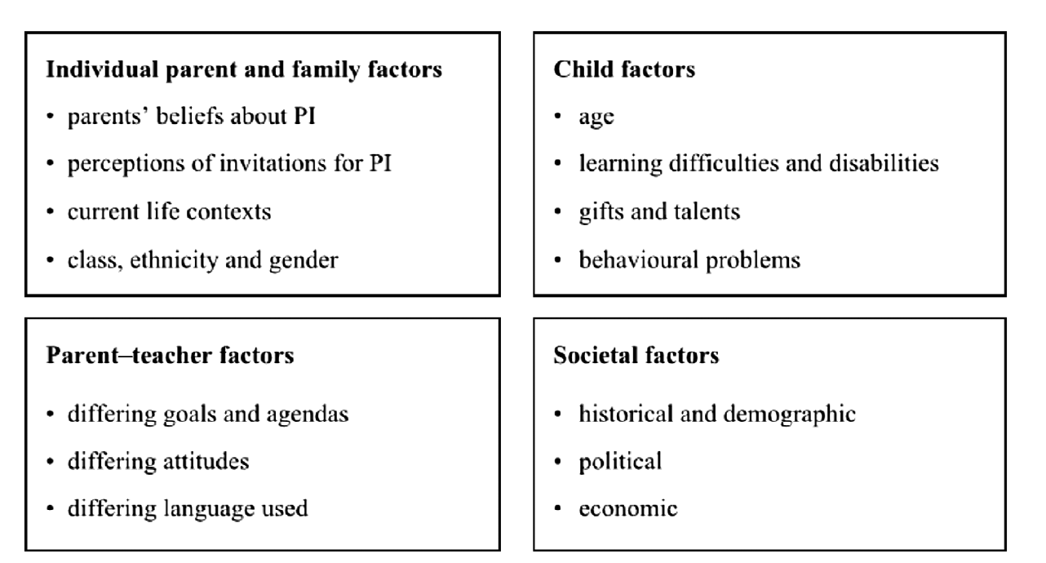
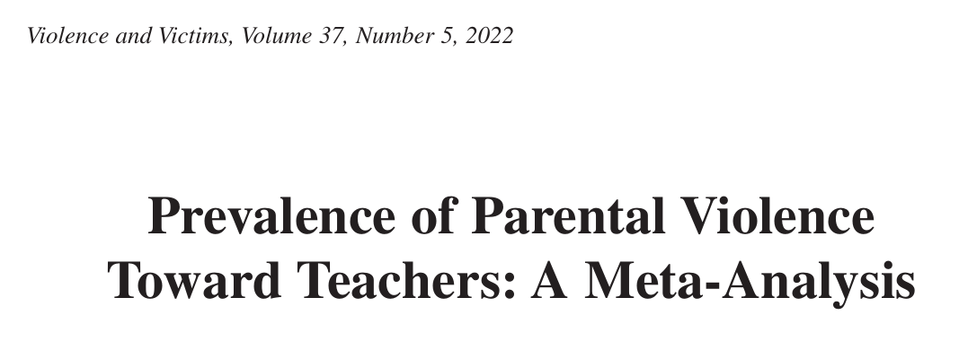
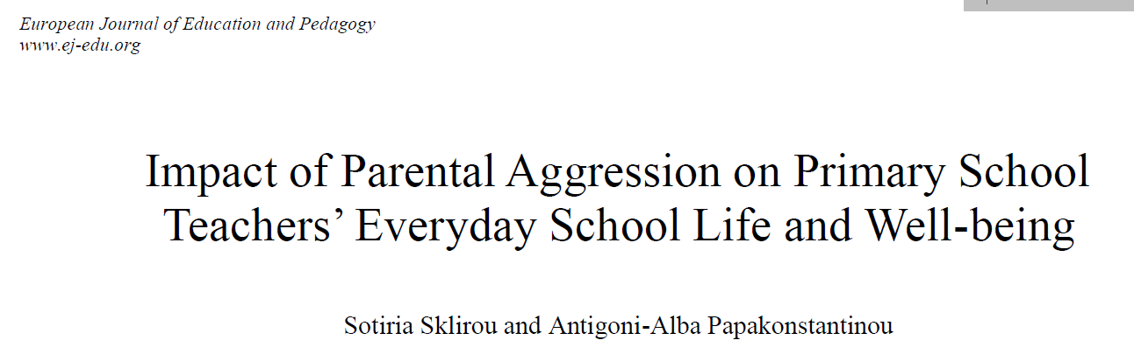
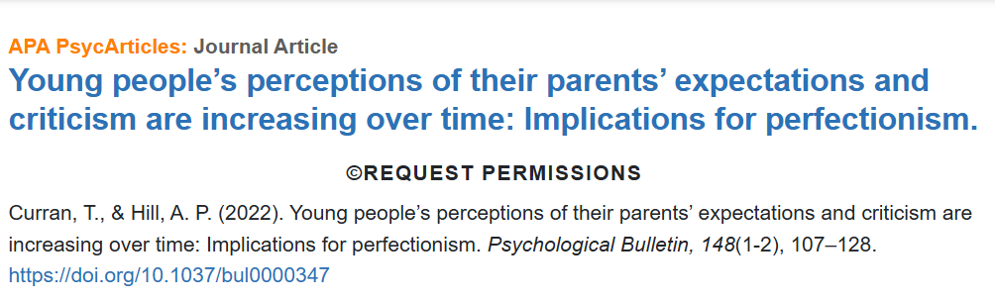
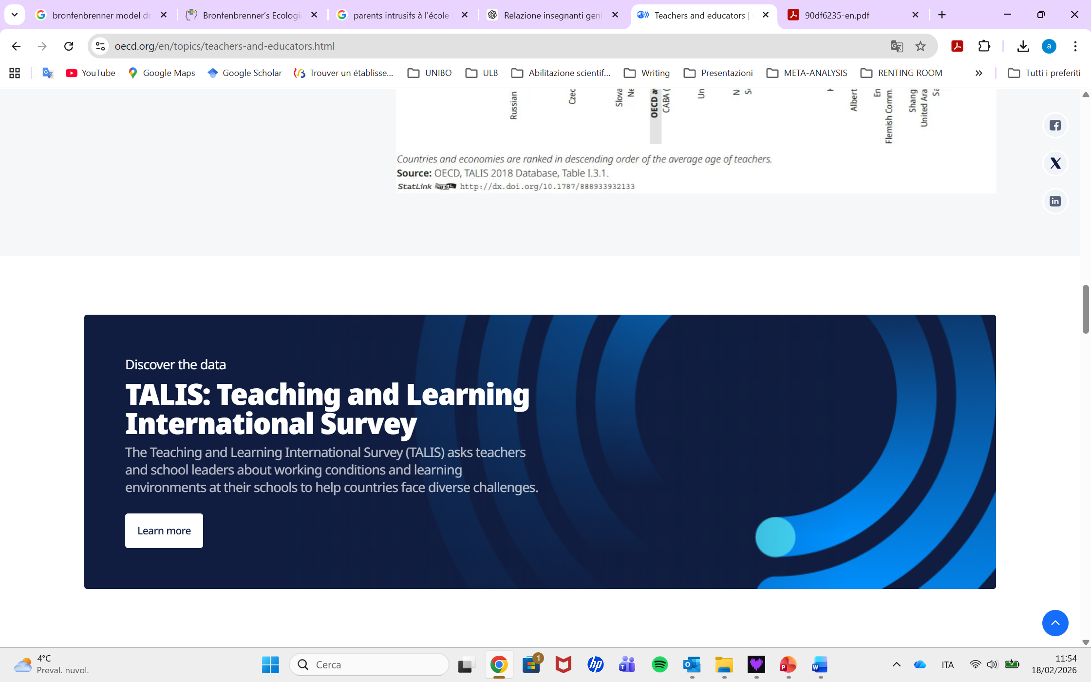
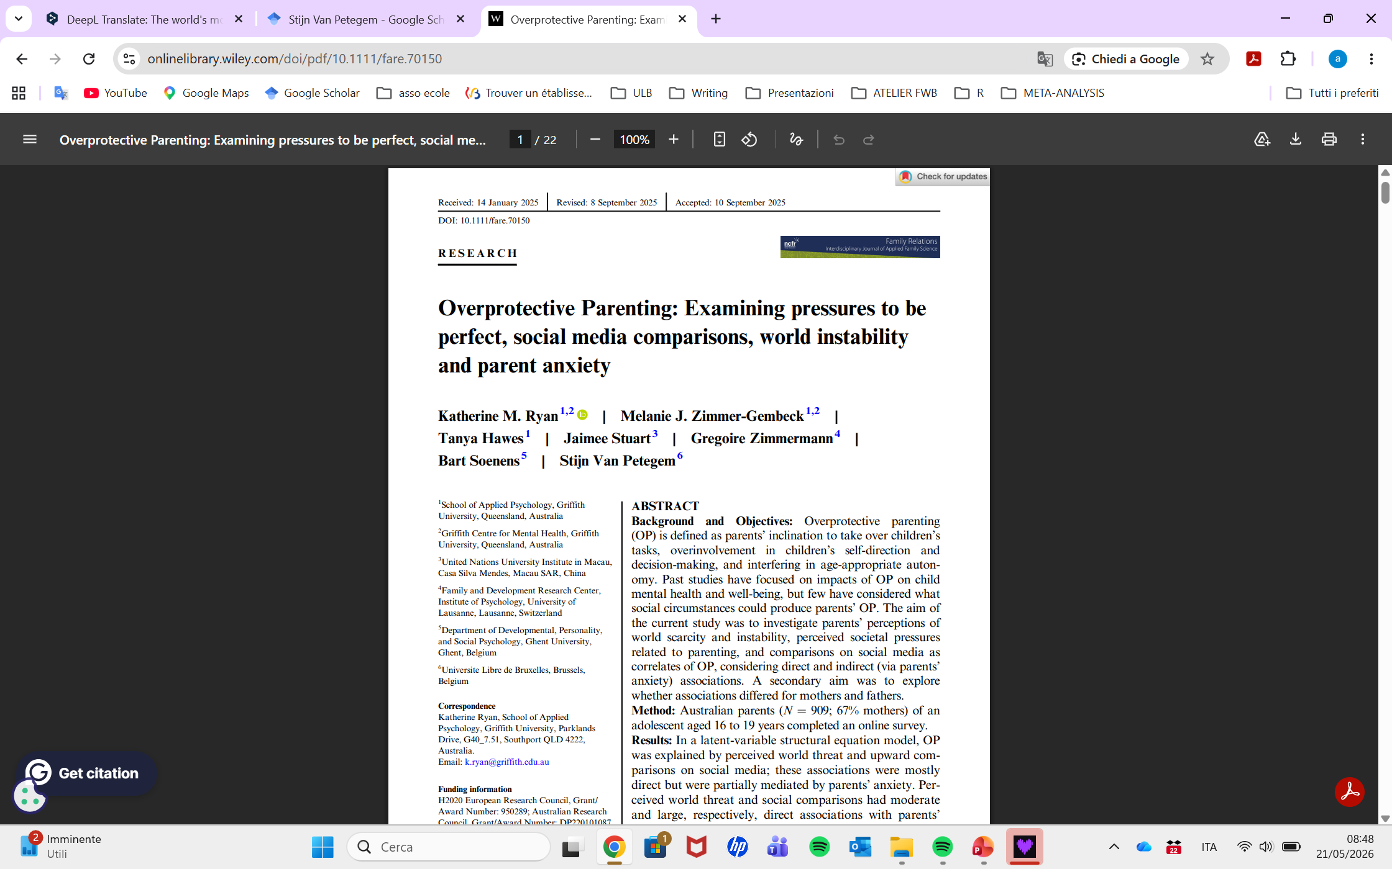
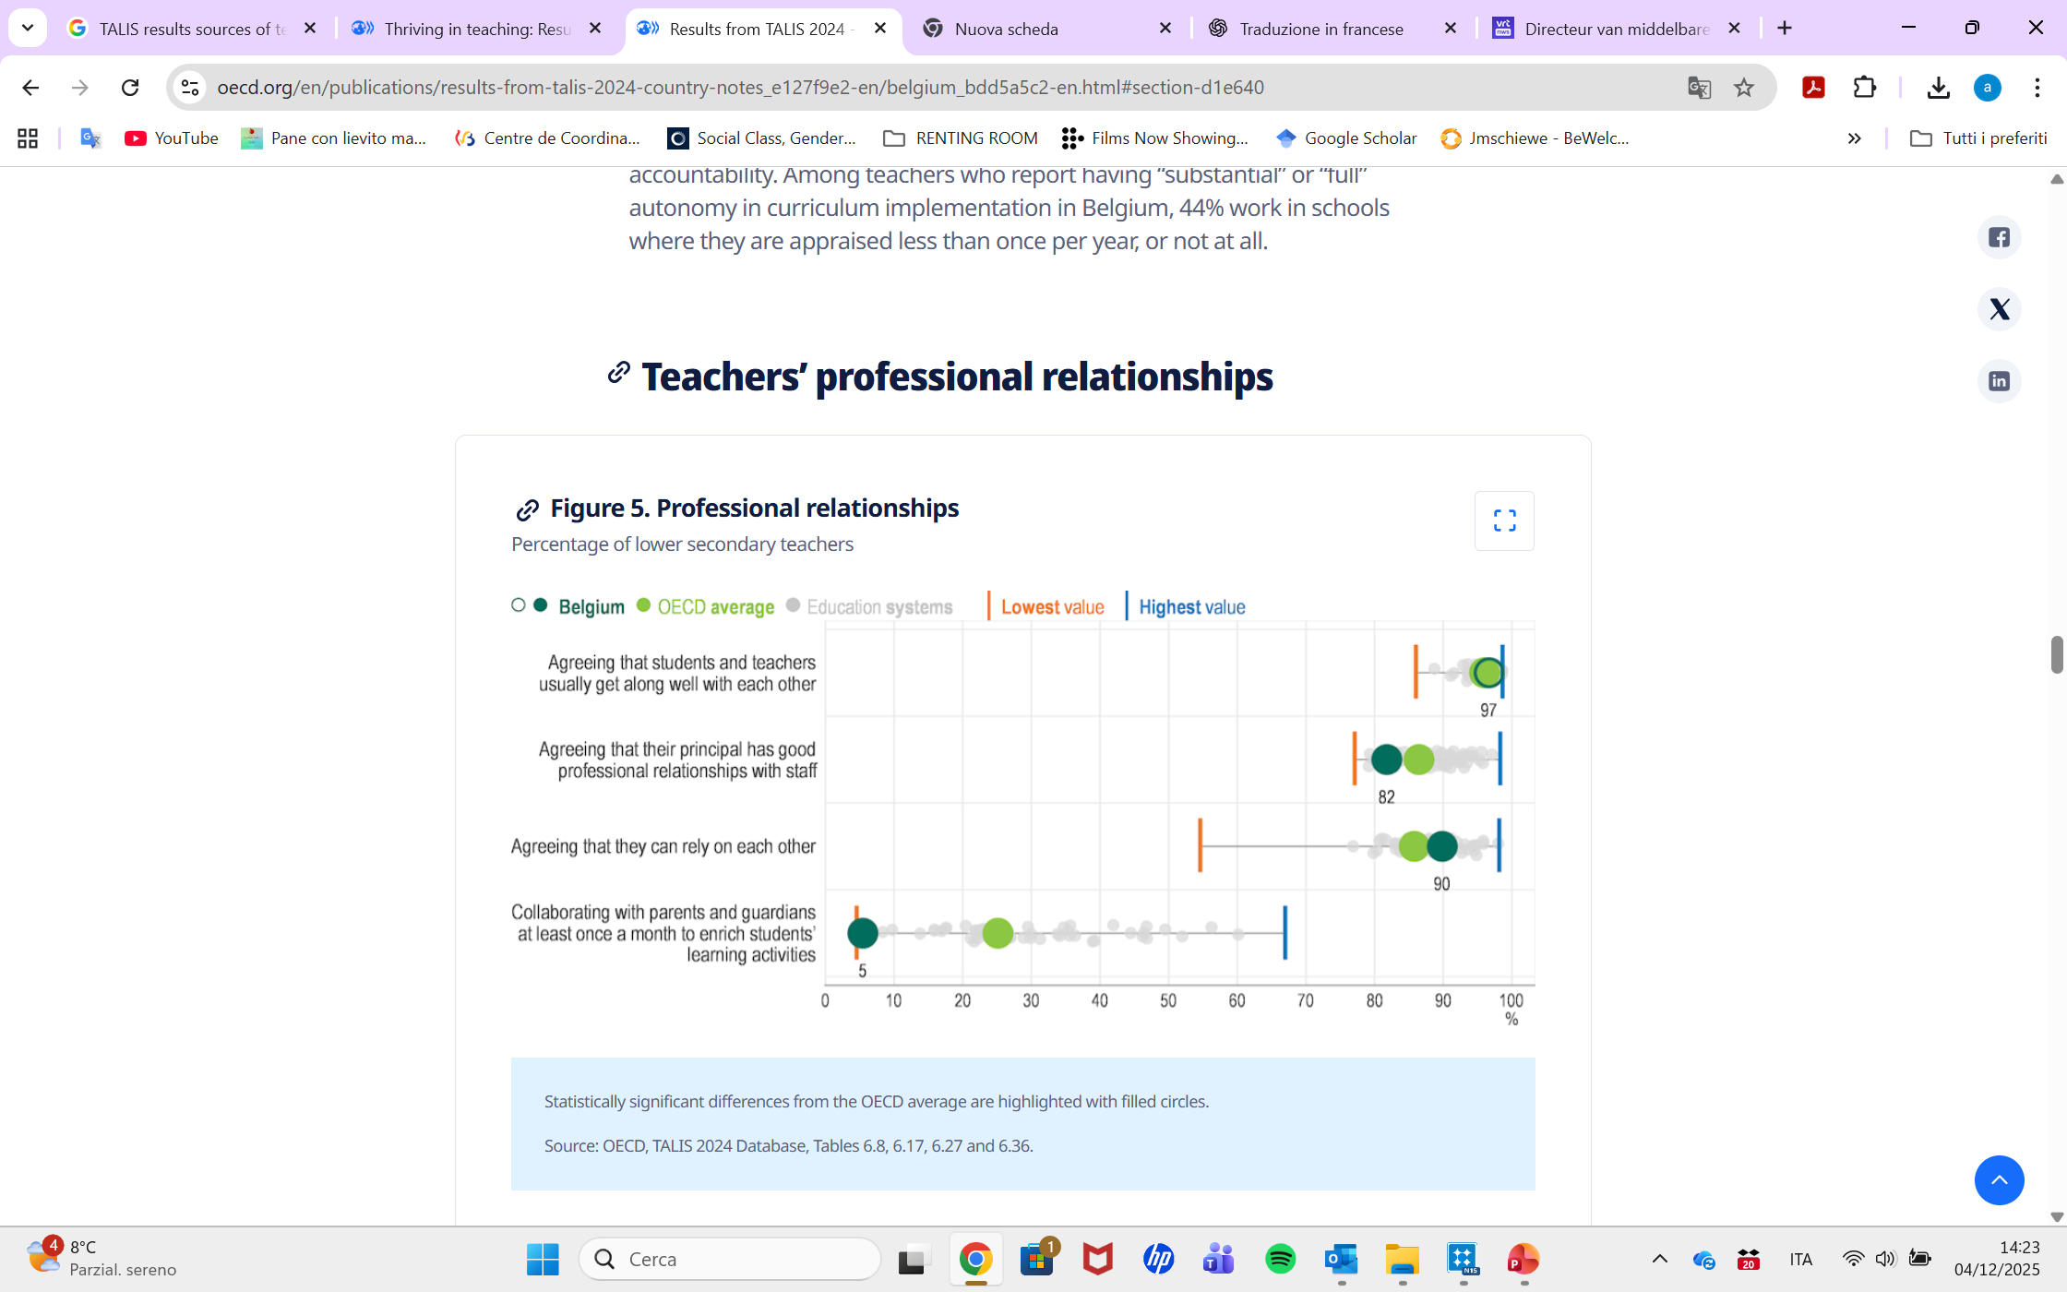
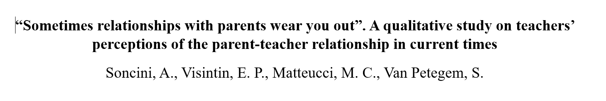
RQ: How do teachers, parents and school directors perceive and describe PI nowadays?
(Curran & Hill, 2022; Badenes-Ribeira et al., 2022; Hornby & Lafaele, 2011; OECD, 2025; Ryan et a., 2026; Sklirou & Papakonstantinou, 2022; Soncini et al., 2026)
Notes:
The Belgian education system is the one in which teachers and parents collaborate least frequently among all the education systems participating in the OECD’s international survey

Slide 4
Sample
29 interviews analysed
School directors
Teachers
n | School level | SES school | Age | Years of experience | Gender
1 | Secondaire | 18 | 59 | 17 | M
2 | Secondaire | 7 | 49 | 4 | M
3 | Primaire (P3-P6) | 5 | 60 | 5 | M
4 | Primaire (P1-P6) | 20 | 54 | 16 | F
5 | Secondaire | 20 | 43 | 2 | M
6 | Primaire (P3-P6) | 5 | 60 | 12 | M
M(SD) |  |  | 54.16 (6.96) | 9.33 (6.50)
n | School level | Age | Years of experience | Gender
1 | Primaire | 30 | 6 | F
2 | Primaire | 53 | 33 | F
3 | Primaire | 56 | 35 | F
4 | Primaire | 30 | 10 | M
5 | Primaire | 50 | 29 | F
6 | Primaire | 46 | 25 | F
7 | Secondaire | 41 | 18 | F
8 | Secondaire | 58 | 31 | F
9 | Secondaire | 40 | 8 | F
10 | Secondaire | 37 | 9 | F
11 | Secondaire | 60 | 35 | F
12 | Secondaire | 36 | 10 | M
13 | Secondaire | 52 | 22 | M
14 | Secondaire | 46 | 10 | M
15 | Secondaire | 43 | 20 | F
16 | Secondaire | 56 | 30 | F
M(SD) |  | 45.87 (9.61) | 20.68 (10.74)
Parents
n | Number of children (age of children) | Age | Civic status | Gender
1 | 2 (7-10) | 43 | Married | F
2 | 2 (21-17) | 62 | Divorced | F
3 | 2 (15-12) | 41 | Married | F
4 | 1 (12) | 50 | Divorced | M
5 | 2 (18-13) | 44 | In a stable relationship | F
6 | 1 (13) | 41 | Married | F
7 | 1 (7) | 52 | Married | F
M(SD) |  | 47.57 (7.67)

Slide 5
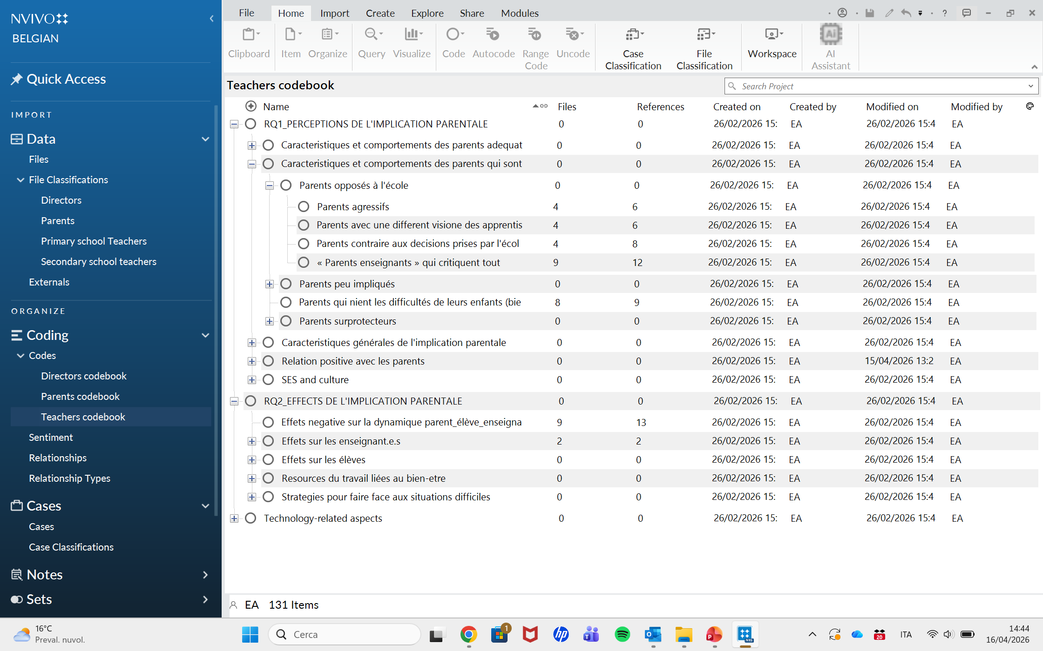
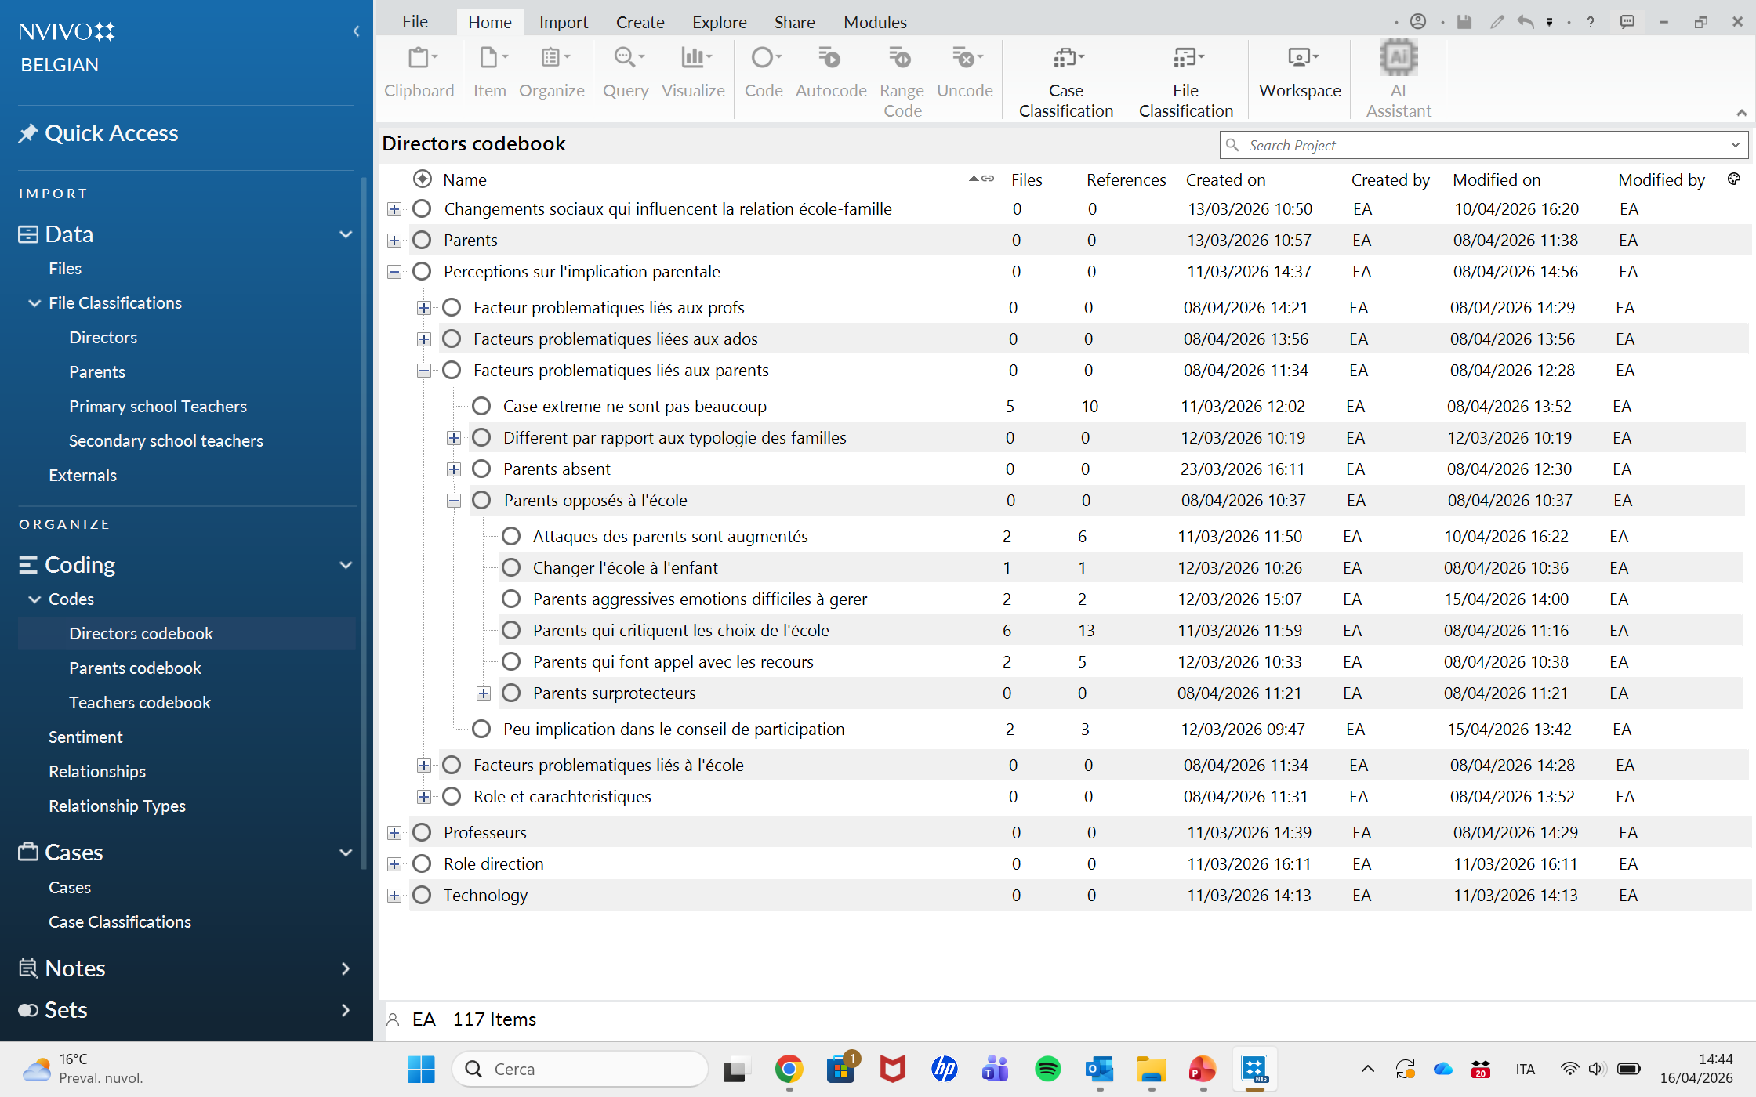
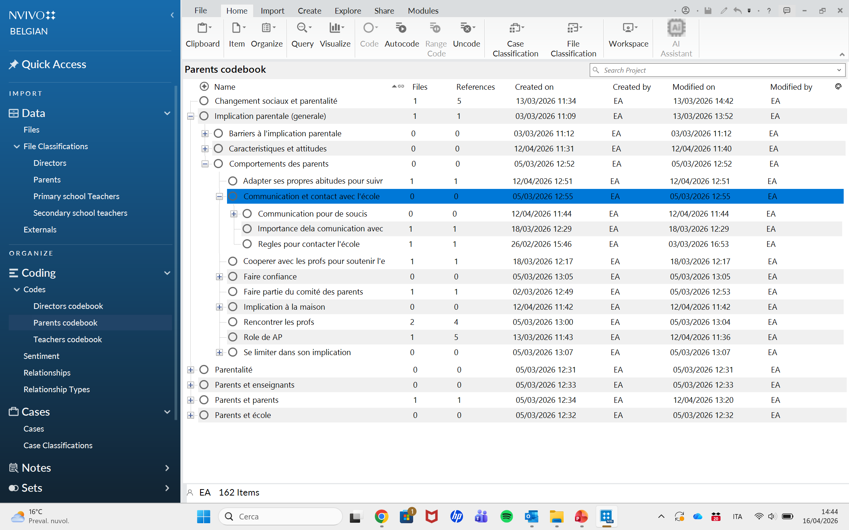
Data analysis
Reflexive thematic analysis - Within-between approach
Within phase
(Braun & Clarke, 2006; 2021)

Slide 6
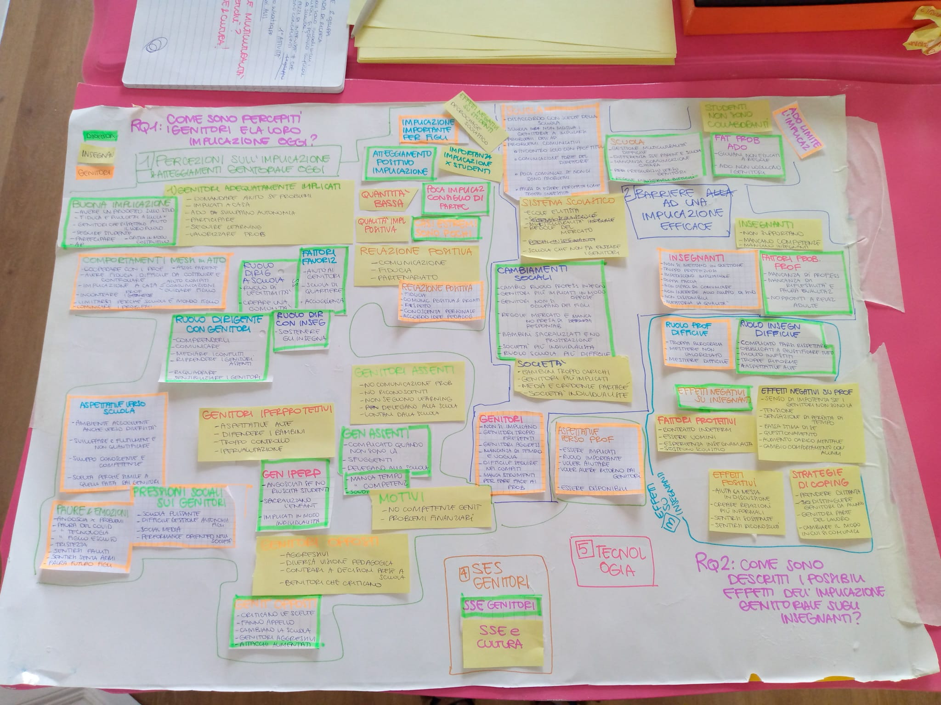
Data analysis
Between phase

Slide 7
Quality and quantity of PI
Positive attitudes towards PI
Quality of PI is good (10)
Quantity of PI is low (7)
Results
PI influences students at school positively (4)
PI is important for the children’s development (2)
Extreme negative cases are rare (5)
Low participations in the school governance
Not adequate parental involvement leads to negative effects on students
PI key aspect of Parent-school-student triangulation (7)
Child factors
Perceptions and attitudes of parental involvement
Effective PI
Facilitating factors
Students do not cooperate
Positive PTR
Home-based involvement, recognising problems, participation and valorisation
Welcoming and open schools
High SES_better PI at home
Teenagers want to keep parents out
PTR based on partnership, transparent communication and trust
Teenagers limit the PI
Supervise and support, trust, participation in school governance and events, respect school role
Directors who support teachers
Low SES_recognition
School system factors
Reciprocity as a key ingredient for PTR
Directors who guide and ré-encadrent the parents
High SES_easier PI and relationship
Challenges related to multiculturality, labour market dynamics, shortage of teachers
School prevent PI
Supervise, trust and communication, participation
Challenging PI
Parents considered as problems and lack of clear communication
Low involved parents_Lack of supervision, reciprocity, interest
Teachers factors
Challenges related to multiculturality, changes in school role and clarity of laws
Opposed, aggressive and criticising parents
Overprotective parents
Lack of teachers’ competencies and elitist beliefs
Parents who criticise and appeal to the school and aggressive
Parents too focused on their children
School not welcoming, lack of effective communication, low meeting with teachers
Lack of professionalism, reflection and improvement, training
Decrease in teachers’ legitimacy
Low involved parents_lack of implication and reciprocity
Too involved parents
Lack of interest, involvement, willingness to involve and good communication skills
Societal factors
Teachers’ job is difficult but not socially valued
Parents not collaborative behaviours
Changes in parenting and narrative related to parents
Parental difficulties
Barriers to an effective PI
Society more individualistic
Parents socio-economic features
Lack of parental skills
Parents perceived pressures
Socio-economic and cultural difficulties fro low SES and migrant parents
Low SES parents do not know the school system and face socio-economic difficulties
Negative parenting changes
Family problems
Fears and negative emotions
Parental expectations
Individualistic society
High SES not always present
Expectations towards the school
Expectations towards the teacher
High SES parents know how to play with the system

Slide 8
Child factors
Results
Students do not cooperate
Teachers factors
Teenagers want to keep parents out
School system factors
Lack of teachers’ competencies and elitist beliefs
Teenagers limit the PI
Challenges related to multiculturality, labour market dynamics, shortage of teachers
School prevent PI
Lack of professionalism, reflection and improvement, training
Decrease in teachers’ legitimacy
Parents are considered a problem and a lack of clear communication
Challenges related to multiculturality, changes in school role and clarity of laws
Lack of interest, involvement, willingness to involve and good communication skills
Barriers to an effective PI
Teachers’ job is difficult but not socially valued
School not welcoming, lack of effective communication, rare meetings with teachers
Parents socio-economic features
Parental difficulties
Societal factors
Socio-economic and cultural difficulties fro low SES and migrant parents
Low SES parents do not know the school system and face socio-economic difficulties
Lack of parental skills
Parents perceived pressures
Changes in parenting and narrative related to parents
Family problems
Fears and negative emotions
Society more individualistic
High SES not always present
High SES parents know how to play with the system
Parental expectations
Negative parenting changes
Expectations towards the school
Expectations towards the teacher
Individualistic society

Slide 9
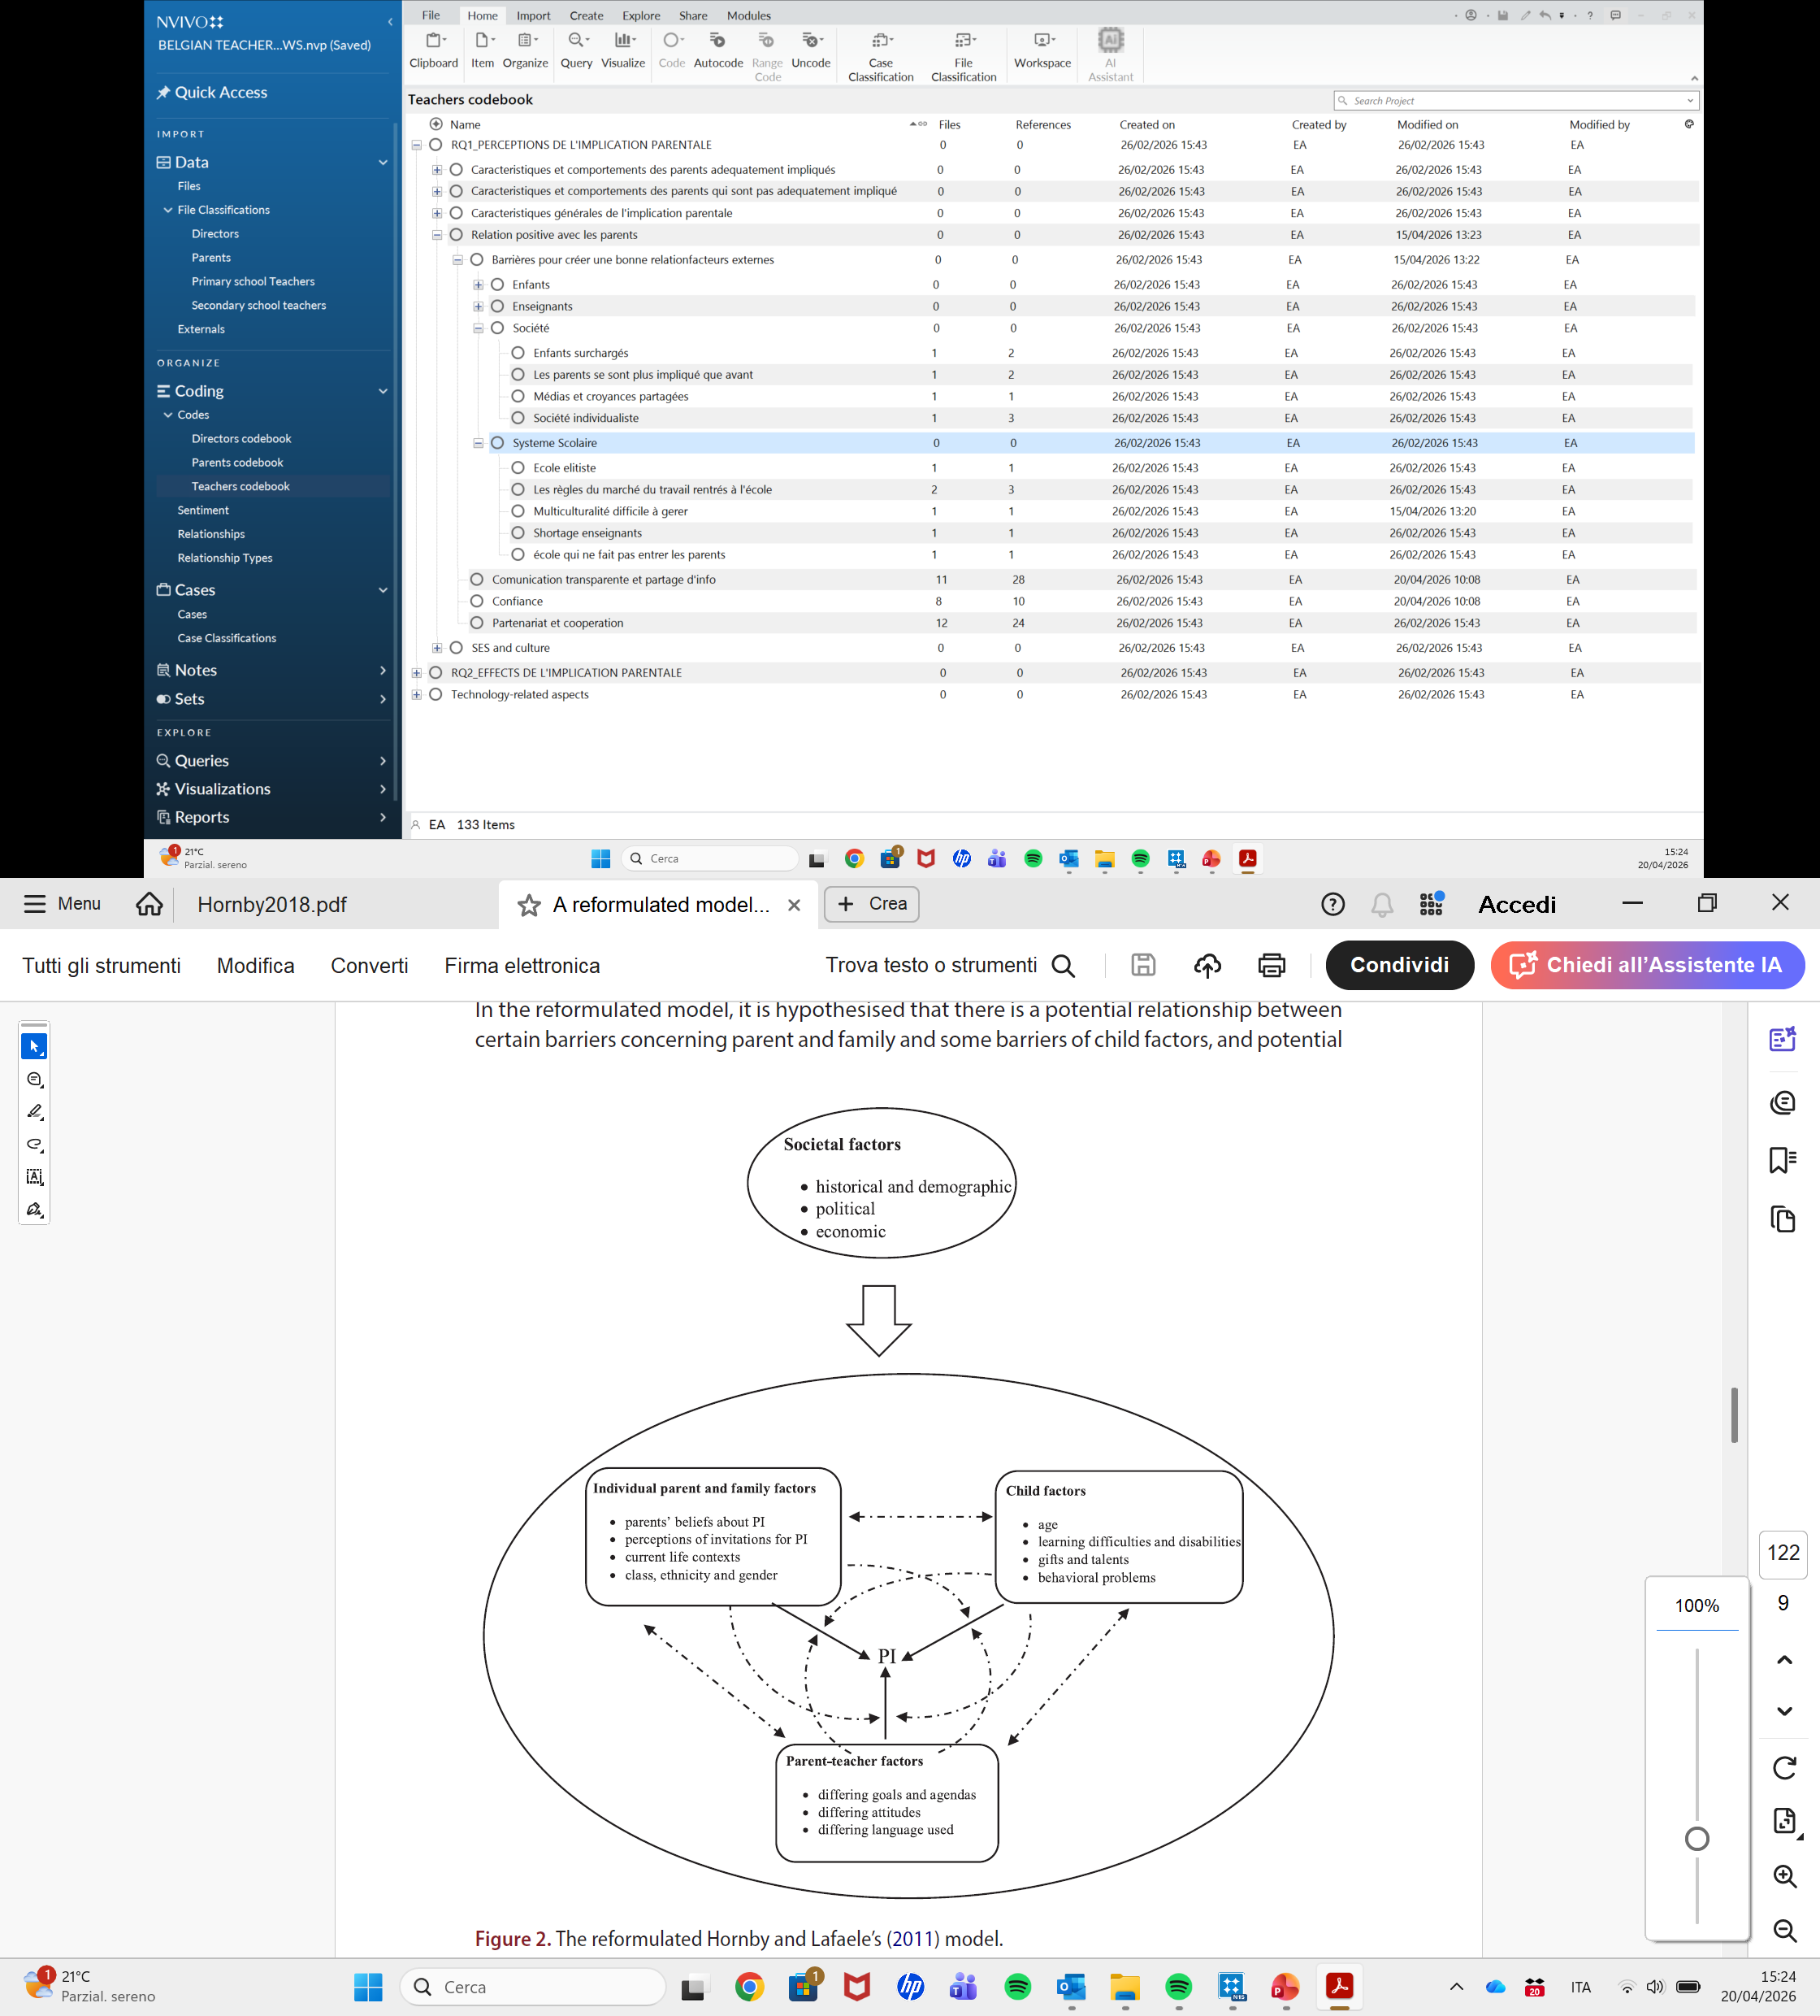
Discussion
Theoretical model by Hornby & Lafaele (2011), reformulated by Fan et al. (2018)

Slide 10
Theoretical model reformulated by Fan et al. (2018)
Societal pressure on parents
School system factors
Teachers factors

Slide 11
2026 Annual meeting of the Belgian Association for Psychological Sciences
Exploring teachers, parents and school directors' perspectives on parental school involvement in the French-speaking community of Belgium.
A multi-informant qualitative study
Annalisa Soncini & Stijn Van Petegem
Université libre de Bruxelles
Thank you for your attention!

